Slide 1


Slide 2
M. L. Project
Flood Prediction using Machine Learning Techniques
Presented By
Harinarayanan K P - MY.SC.I5MCA21019
Saran Shabu - MY.SC.I5MCA21039

Slide 3


Introduction
Purpose
Floods are among the most devastating natural disasters, causing loss of life, property damage, and long-term socio-economic impact. As climate change intensifies, the frequency and severity of floods are expected to increase, demanding robust early-warning systems.
The Role of Machine Learning
Machine learning (ML) has emerged as a powerful tool in flood prediction. By analyzing historical meteorological and geographical data, ML models can uncover complex patterns and provide accurate, data-driven forecasts that aid disaster preparedness and response.

Slide 4
Purpose
This study presents and compares two machine learning models for flood prediction:
  Random Forest Regressor: A robust ensemble-based regression technique suitable for continuous flood probability prediction .
  Support Vector Machine (SVM) Classifier: A powerful classification model effective in categorizing regions into discrete flood risk levels (High, Medium, Low).

Slide 5

Objectives
  Develop machine learning-based flood prediction models.
  Implement regression and classification techniques.
  Evaluate performance metrics to assess model reliability.
  Propose future directions to improve accuracy and efficiency.
  Evaluate and Understand the correlation of the features.

Slide 6

Dataset Used
  Source: Meteorological and hydrological records.
  Attributes: Rainfall, soil moisture, river levels, urbanization, dam quality, etc.
  Target variable: Flood Probability (continuous or binned).
  Data split: 80% training, 20% testing.

Slide 7

Attributes and Target Class
  Sourced from the UCI Machine Learning Repository.
  Contains 50,000 rows and 21 features representing meteorological, geographical, environmental, and socio-economic indicators.
Key Attributes (Features)
  MonsoonIntensity – Volume of rainfall during monsoon seasons.
  RiverManagement – Effectiveness of river flow and infrastructure.
  Deforestation – Area affected by deforestation.
  Urbanization – Development level in flood-prone zones.

Slide 8
Attributes and Target Class
Target Class: FloodProbability
  Originally a continuous variable (0 to 1 range).
  Binned into 3 categories for classification:
    Low Risk (0): FloodProbability < 0.45
    Medium Risk (1): 0.45 ≤ FloodProbability ≤ 0.55
    High Risk (2): FloodProbability > 0.55

Slide 9



What We Learned from Past Studies
  📊 Various machine learning models like SVM, RF, ANN, and LSTM have been used for flood and disaster prediction, showing promising accuracy.
  🌍 GIS integration and time-series forecasting enhance spatial analysis and real-time flood monitoring.
  ⚠️ Common limitations include data quality issues, high preprocessing times, and difficulty generalizing models like CNN and LSTM.
Why We Chose Random Forest & SVM
  Random Forest is robust, handles non-linear relationships well, and provides reliable predictions with minimal overfitting.
  SVM excels in classification tasks with clear decision boundaries, especially effective with high-dimensional and imbalanced data.
Literature Summary

Slide 10
Support Vector Machine
  Tool: Python (Scikit-learn)
  Target: Categorical flood risk
  Output: Predicted class (High/Medium/Low)
Evaluation:
  Accuracy, Precision, Recall, F1-Score
  Confusion Matrix

Slide 11
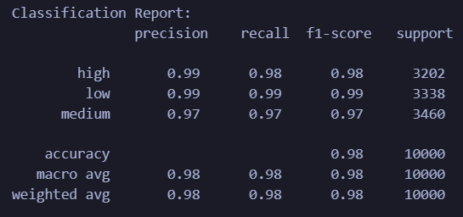
Classification Report

Slide 12
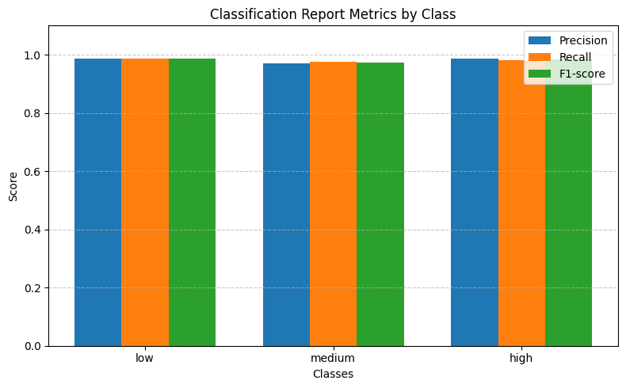
Classification Report
Mean Accuracy:
0.97965

Slide 13
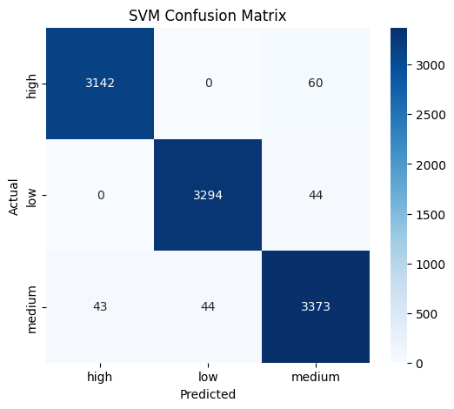
Confusion Matrix
Very Few Misclassifications
  Minimal errors, indicating excellent class separation by the SVM model.
  Off-diagonal values:
    60 High were predicted as Medium.
    44 Low were predicted as Medium.
    43 Medium were predicted as High.
    44 Medium were predicted as Low.

Slide 14
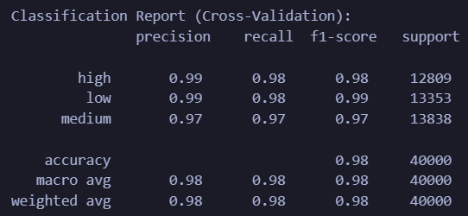
Cross-Validation Report
Stratified K- Fold
Mean Accuracy:
0.97965

Slide 15
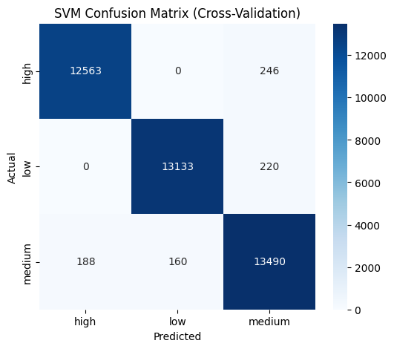
Cross-Validation Confusion Matrix
High Correct Classification Across All Classes
  High → High: 12,563
  Low → Low: 13,133
  Medium → Medium: 13,490
  Indicates strong and consistent model performance across all folds.
Minimal Misclassifications
  Slight confusion between Medium and High (188) and Medium and Low (160).
  High and Low have zero misclassification with each other — shows SVM effectively separates extreme categories.

Slide 16

Random forest

Slide 17
MODEL OVERVIEW
Random Forest algorithm, which is an ensemble method combining multiple decision trees to improve prediction accuracy and mitigate overfitting.
Key performance metrics include Mean Squared Error (MSE), Mean Absolute Error (MAE), and R² Score
It utilizes cross-validation (K-Fold method) to assess performance and ensure generalization.
Regression plot, heat map to understand the correlation of the features.

Slide 18
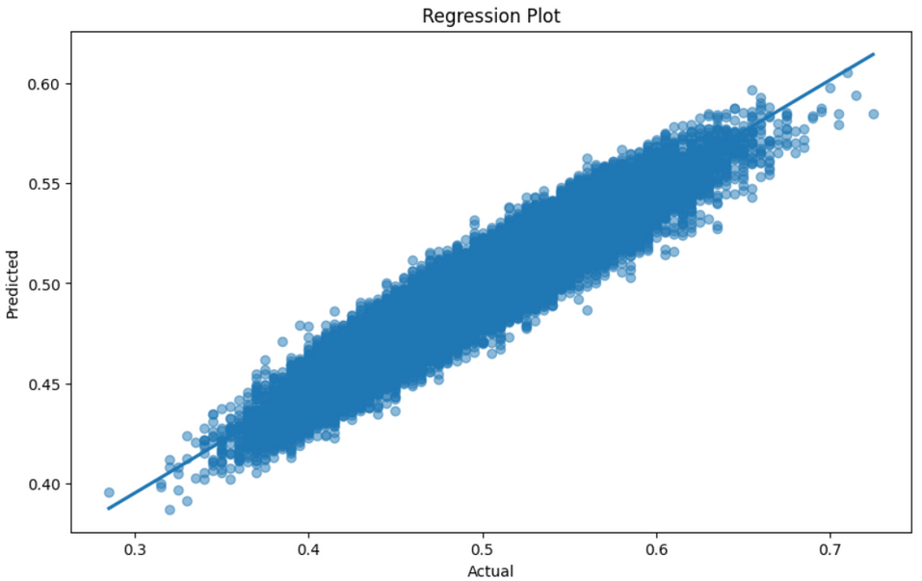
RESULTS
Cross-Validation MSE Scores: [0.00067594 0.0006716 0.00067117 0.00066959 0.00067005]
Mean CV MSE: 0.0006716691257500004
Overall Model Evaluation:
Mean Squared Error: 0.0006716691257500004
Mean Absolute Error: 0.02041217900000001
R^2 Score: 0.7316962416991346

Slide 19
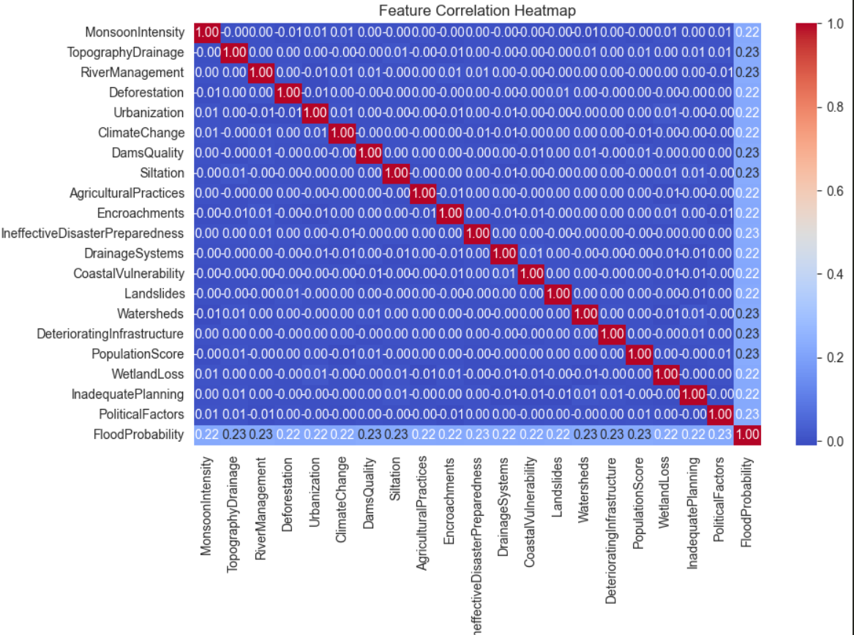





CORRELATION OF THE FEATURES

Slide 20
Conclusion
  98%+ accuracy across all classes on SVM
  Robust results even under Stratified K-Fold Cross-Validation, indicating excellent generalizability.
  Random Forest offers better interpretability and is effective in capturing complex, non-linear relationships in data.
  Useful for understanding feature importance and probabilistic risk scoring.
Future Directions
  Explore hybrid models (e.g., combining SVM and deep learning).
  Integrate real-time sensor and satellite data for dynamic prediction.
  Apply explainable AI techniques to enhance trust and transparency in predictions.
  Extend the system for multi-hazard scenarios (e.g., flood + landslide).
Why use both?
  Each model brings unique strengths: SVM for crisp classification and RF for flexible regression.
  They can complement each other in a hybrid or ensemble setup.

Slide 21

THANK YOU

